Slide 1


KEYCLOAK Advance Keycloak: SSO Course from Zero to Hero
Course By Arnab Das

Slide 2

What is Keycloak ?
Keycloak is an open source software product that allows single sign-on with identity and access management aimed at modern applications and services.
It supports multiple protocols such as OpenID Connect, OAuth 2.0, and SAML 2.0. It also provides features such as user federation, social login, multifactor authentication, and authorization services.

Slide 3
Course Timeline
02
05
Keycloak Basics
Integration with Full-Stack Application
01
Installation
03
04
Using Keycloak APIs
Creating Custom Keycloak Templates

Slide 4







About Me
Arnab Das
(Senior Member Of Technical Staff) At Edgeverve
19+ Hackathons Winner || Backend || ML/AI || Blockchain || Angular
LinkedIn
Gmail
X / Twitter
Instagram
YouTube
in/raj713335/
raj713335@gmail.com
raj713335
raj713335
@intelegixlabs295

Slide 5





Why Learn Keycloak ?
01
02
03
04
05
User registration and Login
Developer can focus on core technology
Uses best practices
Centralized user Management
SSO, Social Identity Providers, and Federation

Slide 6

01
Chapter
Installing Keycloak

Slide 7
Lesson Outline
1
2
3
4
5
Install Java JDK dependency​
Install Keycloak Server
Install PostgreSQL Database​
Install pgAdmin
Connect Keycloak with the database

Slide 8

02
Chapter
Configure Keycloak

Slide 9
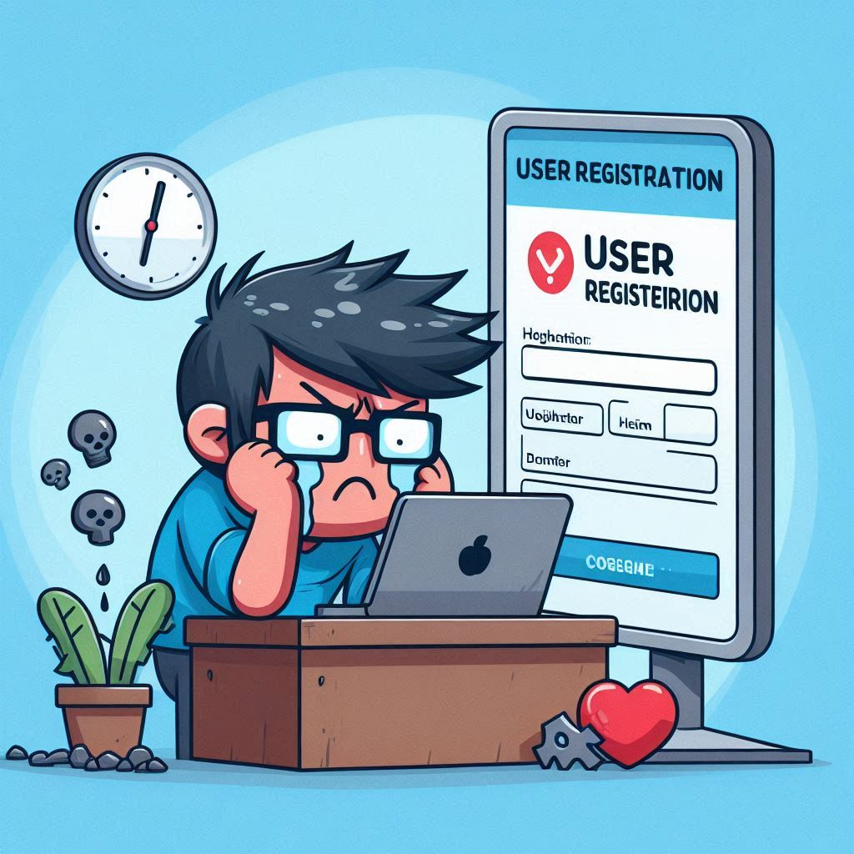
Keycloak Admin Console
It’s the control center for managing all aspects of your Keycloak server. Whether you’re an administrator or a realm manager, this console is your gateway to configuring, securing, and orchestrating the entire Keycloak ecosystem.
Realm Management
User Management
Application Management
Security Configurations
Fine-Grained Authorization
Themes and Customization

Slide 10
Configure Keycloak Lesson Outline
1
2
3
4
Realm Settings
Authentication
Identity Providers
User federation

Slide 11
Manage Keycloak Lesson Outline
1
2
3
4
5
6
7
Clients
Clients scopes
Realm roles
Users
Groups
Sessions
Events

Slide 12

Keycloak Clients
What is a client in Keycloak?
Clients are entities that can request authentication of a user.
2. Types of clients ?
Type 1: An application that wants to participate in single-sign-on
Type 2: An application that requests an access token to invoke other services on behalf of the authenticated user.
3. Client communication protocols (OpenID Connect, SAML)
- Keycloak supports both OpenID Connect (OIDC) and SAML protocols for communicating with clients.
- OIDC is preferred since it was designed to be web-friendly and work well with HTML5 & JavaScript applications.
- SAML is a mature protocol but it tends to be a bit more verbose than OIDC
- But with Keycloak, developers have the freedom to choose any of the above protocols based on their requirements.

Slide 13
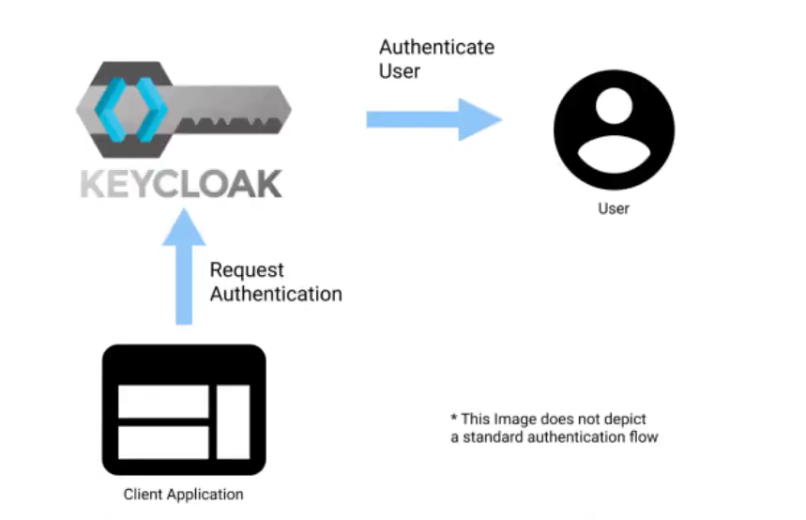
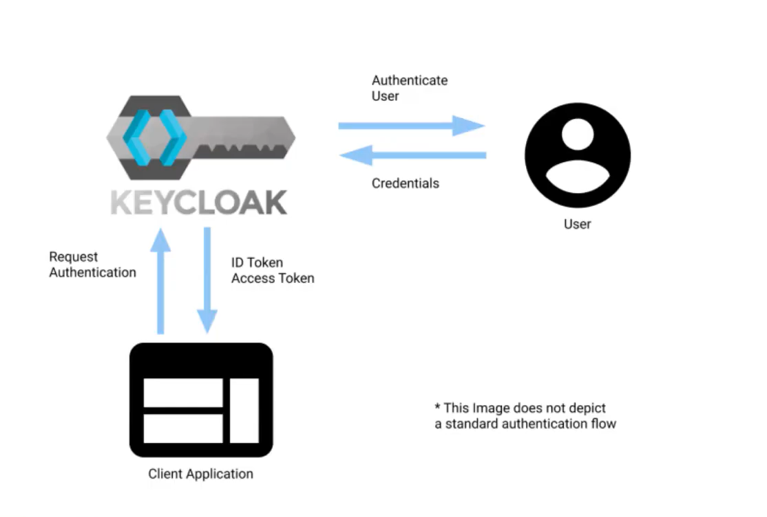
Keycloak Clients

Slide 14

03
Chapter
Using Keycloak RestAPIs

Slide 15

04
Chapter
Creating Keycloak Custom Templates

Slide 16
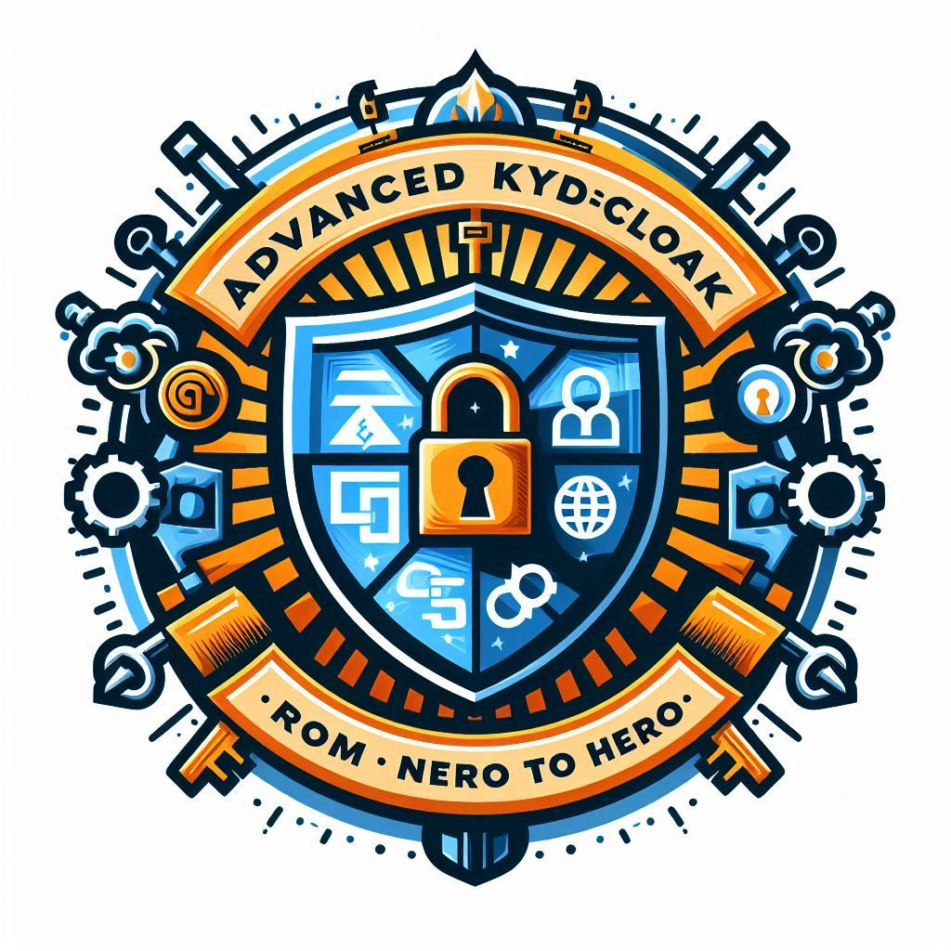
Customize and extend Keycloak
Keycloak is highly configurable and extensible, allowing you to customize its look and feel, add new features, and integrate with other systems.
You can use themes, templates, and internationalization to change the appearance of Keycloak’s user interface.
You can also use extensions, such as SPIs, event listeners, and user storage providers, to add new functionality and logic to Keycloak. You can also use REST APIs and an admin console to manage Keycloak programmatically.

Slide 17

05
Chapter
Integration with Full Stack Application

Slide 18
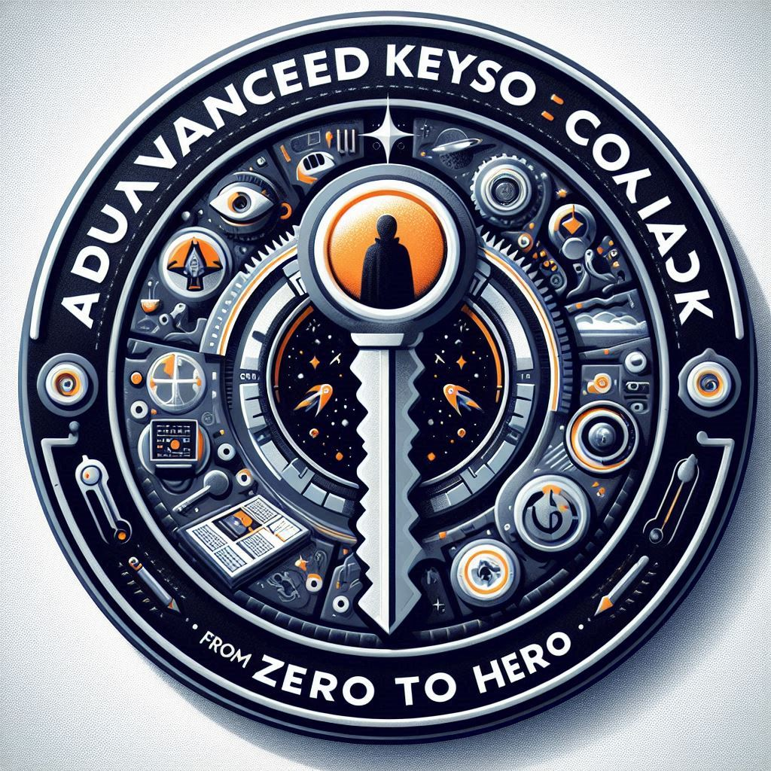
Secure microservices and APIs
Keycloak can be used to secure microservices and APIs by providing authentication and access control based on standard protocols like OpenID Connect and OAuth 2.0.
This ensures that only authorized users and applications can access your services, helping to maintain the security and integrity of your infrastructure.

Slide 19

Integrate with external identity providers
Keycloak can act as an identity broker that allows users to authenticate with external identity providers, such as Google, Facebook, or LDAP.
This simplifies the user experience and reduces the need to manage multiple user accounts and passwords.
Keycloak can also synchronize user data and attributes from external sources, and map them to roles and groups within Keycloak.

Slide 20
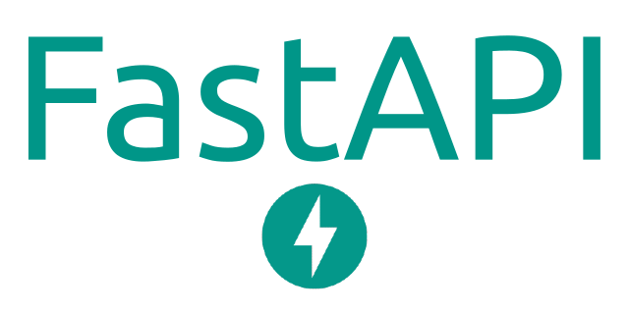


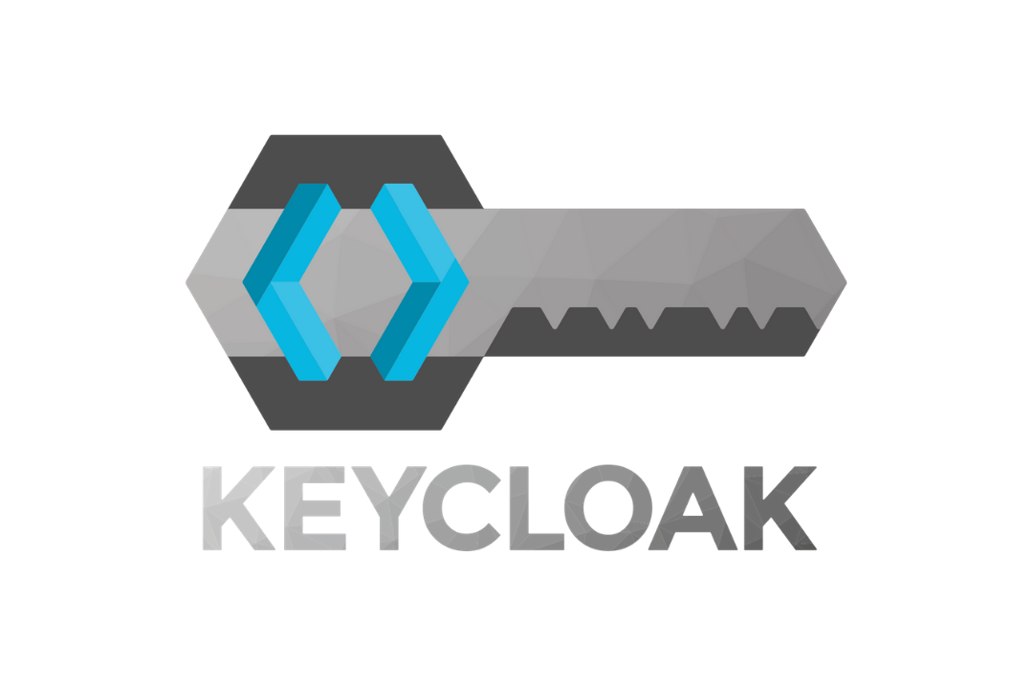




Full Stack Architecture
Keycloak
React
python-keycloak
Keycloak-js

Slide 21







Thank you
Arnab Das
raj713335@gmail.com
https://www.linkedin.com/in/raj713335/

